Slide 1
DXC – Realtime Project
Name- Aishee Bhattacharya
Reg no.: DXC262AB1204
Date: 13/06/2022

Slide 2
Project 1: Smart vehicles
Problem statement:
General motors is one of the leading heavy vehicle manufacture company. To improve they are planning to roll out lot new features based on IOT.
Vehicle has third party IOT device which will send the telemetry data in JSON format over the AWS cloud.
We need to validate the JSON
Once JSON gets validated this data would be stored in SQL database which will further be utilized by data science team.

Slide 3
Block diagram:
AWS
Copy data in Azure
Validate JSON
Store in SQL Database

Slide 4
Objective:
Create Azure Data Factory Account For Data pipelines
Create ADF Pipeline End to end pipeline with triggers enable
Create Azure blob trigger logic
Create Azure SQL Server and Database
Add another pipeline for moving data from Staging to SQL DB

Slide 5
Approach:
Create data factory
Create storage account
Once deployment is completed go to resource group and click on containers.
We create a source blob and we upload a sample file.
Create SQL database
We need to create a SQL database in order to send the data.
Open the Azure Data Factory , Click on + Create option to create a new Data Factory account.
After entering the details Click on Create when successfully validated
Once deployment is completed we click on go to resource and open Azure data factory studio
Connect the database with new connection.
Here, the SQL database is our destination

Slide 6
Create a pipeline
Now we need to open Azure Data Factory in order to create a pipeline that will take data from blob storage and feed into the SQL database.
Click on ingest
Link the data factory with sql database
In order to link the Data Factory with SQL database .Connect the database with new connection.
We select the target type and connection for the destination data store.
Trigger the pipeline
Select add trigger on the toolbar and then select trigger now.The pipeline run dialog box asks for the name parameter. Use/path filename as parameters here.
Then we can see the pipeline run
Enter the name of Azure blob storage linked file. Select the name of storage account that we created previously.
Then the format of the data is chosen
We then move to SQL database in order to check the data.
Deployment is done

Slide 7
Conclusion:
Azure Pipelines supports continuous integration (CI) and continuous delivery (CD) to continuously test, build, and deploy the code.
In this project we successfully created a pipeline that validated and copied the blob data into the SQL database using Azure Data Factory
Continuous Integration (CI) is the practice used by development teams of automating, merging and testing code. Implementing CI helps to catch bugs early in the development cycle, which makes them less expensive to fix.

Slide 8
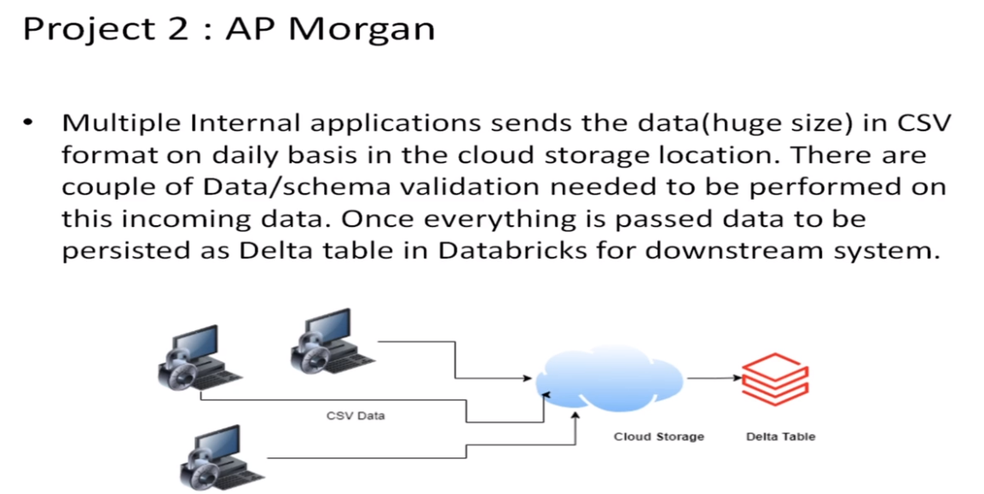
Project 2: AP Morgan

Slide 9
Problem statement:
Internal Application sends csv file in Azure data lake storage.
Validation needed to apply on this follows:
1.Check for duplicate rows. If it contains duplicate rows,file need to be rejected.
2. Need to validate the date format for all the data fields. Date column names and desired data format is stored in a Azure SQL server if validation fails file will be rejected.
Move all the rejected files to eject folder.
Move all the passed files to staging folder.
Write the passed files as the delta table in the Azure Databricks.

Slide 10
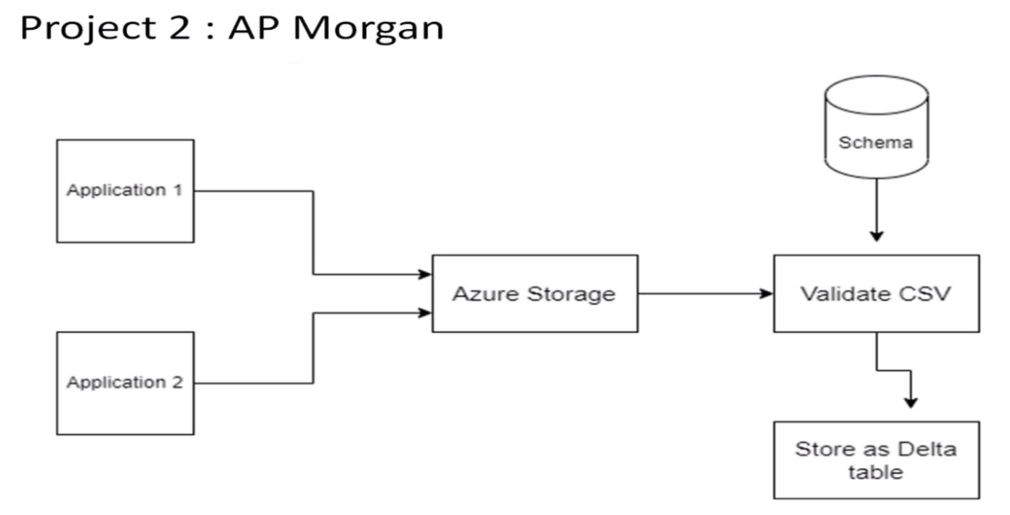
Block diagram:

Slide 11
Objective:
Create a Databricks
Create Cluster in Azure Databricks
Add notebook in Databricks and Implement the Business Logic
Create Azure Data Factory For AP Morgan
Create Azure Databricks Linked Service in ADF

Slide 12
Approach:
Create an azure databricks
create a new account into the Data Bricks
After entering the details we need to give permission for cluster connectivity.
Create a new cluster
By giving the necessary details and click on create
Create a new notebook
Similarly we crate a notebook
Once the notebook is ready to be linked and executed in Azure Data Factory
Once the validation is succeeded and deployment is completed we click on go to resource
We proceed to azure data factory

Slide 13
Create a Data factory
Open the Azure Data Factory , Click on + Create option to create a new Data Factory account.
Create a pipeline
In order to create a pipeline that will connect Data Bricks notebook with Data Factory.
After creating the new pipeline we drag & drop the notebook from Azure Databricks into the pipeline workspace.
In order to get the access token of Data bricks account we navigate to Data bricks and go to Users in settings click on generate token and copy the token
Paste the access token in the data factory new linked service tab and select the right cluster
After entering the details Click on Create when successfully validated
Once deployment is completed we click on go to resource and open Azure data factory studio
Publish the pipeline in order to trigger it , and then click on “Trigger now”
Switch to the monitor tab to check if we have successfully triggered a linked notebook of Data bricks from Data Factory.

Slide 14
Conclusion:
Our motive was to link Azure Databricks notebook using Data factory.
By orchestrating Databricks notebooks through Azure Data Factory, we get the best of both worlds from each tool. The native connectivity, workflow management and trigger functionality built into Azure Data Factory, and at the same time we get the limitless flexibility to code within Databricks.
In this project we were successfully able to link and trigger azure Data Bricks notebook using Data Factory.

Slide 15
THANK YOU!

